Slide 1
DEEP LEarNiNg MastEr Class
Day-18

Slide 2
01
CNN – Brain TUmor Classification
Concept

Slide 3
02
GUI - Classification
Concept

Slide 4
UI file to Python File
python -m PyQt5.uic.pyuic -x SAMPLE.ui -o sample.py

Slide 5
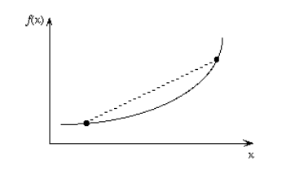
Data science Terminology - 1
Convex Function
A real value function is called convex if the line segment between any two points on the graph of the function lies above or on the graph.
Convex functions play an important role in many areas of mathematics. They are especially important in the study of optimization problems where they are distinguished by a number of convenient properties.

Slide 6
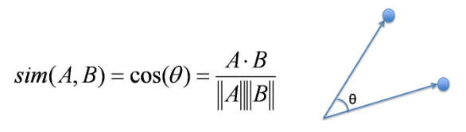
Data science Terminology - 2
Cosine Similarity
Cosine Similarity is the cosine of the angle between 2 non-zero vectors. Two parallel vectors have a cosine similarity of 1 and two vectors at 90° have a cosine similarity of 0. Suppose we have two vectors A and B, cosine similarity of these vectors can be calculated by dividing the dot product of A and B with the product of the magnitude of the two vectors.

Slide 7
Deep Learning Terminology - 3
ETL
ETL is the acronym for Extract, Transform and Load. An ETL system has the following properties:
It extracts data from the source systems
It enforces data quality and consistency standards
Delivers data in a presentation-ready format
This data can be used by application developers to build applications and end users for making decisions.

Slide 8
Achieve what you really want
Short bytes – D18
Secret Rhonda Byrne Movie/Book

Slide 9
Thanks!
Thanks!
Follow Me on LinkedIn : Link in Description
+91 7305845758
Pantechsolutions.net

